Slide 1


PYTHON
Lecture 26

Slide 2

Today’s Agenda
List -II
Modifying A List
Deletion In A List
Appending / Prepending Items In A List
Multiplyng A List
Membership Operators On List

Slide 3

Modifying A List
Python allows us to edit/change/modify an element in a list by simply using it’s index and assigning a new value to it
Syntax:
list_var[index_no]=new_value
Example
sports=["cricket","hockey","football"]
print(sports)
sports[1]="badminton"
print(sports)
Output

Slide 4
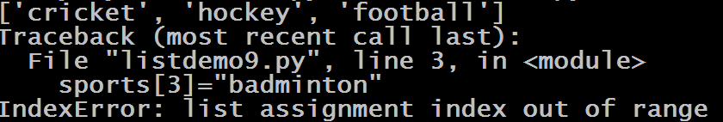
Guess The Output ?
sports=["cricket","hockey","football"]
print(sports)
sports[3]="badminton"
print(sports)
Output:

Slide 5
Modifying Multiple Values
Python allows us to modify multiple continuous list values in a single statement , which is done using the regular slice operator.
Syntax:
list_var[m:n]=[list of new value ]
Example:
sports=["cricket","hockey","football","snooker"]
print(sports)
sports[1:3]=["badminton","tennis"]
print(sports)
Output:

Slide 6
Guess The Output ?
sports=["cricket","hockey","football","snooker"]
print(sports)
sports[1:3]=["badminton","tennis","rugby","table
tennis"]
print(sports)
Output:
The number of elements inserted need not be equal to the number replaced. Python just grows or shrinks the list as needed.

Slide 7
Guess The Output ?
sports=["cricket","hockey","football","snooker"]
print(sports)
sports[1:2]=["badminton","tennis","rugby","table
tennis"]
print(sports)
Output:

Slide 8
Guess The Output ?
sports=["cricket","hockey","football","snooker"]
print(sports)
sports[1:1]=["badminton","tennis"]
print(sports)
Output:
If we have end index same or less than start index , then Python doesn’t remove anything . Rather it simply inserts new elements at the given index and shifts the existing element

Slide 9
Guess The Output ?
sports=["cricket","hockey","football","snooker"]
print(sports)
sports[1:0]=["badminton","tennis"]
print(sports)
Output:

Slide 10
Guess The Output ?
sports=["cricket","hockey","football","snooker"]
print(sports)
sports[1:-1]=["badminton","tennis"]
print(sports)
Output:
Since -1 is present in the list , Python removed items from 1 to second last item of the list and inserted new items there

Slide 11
Guess The Output ?
sports=["cricket","hockey","football","snooker"]
print(sports)
sports[1:-2]=["badminton","tennis"]
print(sports)
Output:

Slide 12
Deleting Item From The List
Python allows us to delete an item from the list by calling the operator/keyword called del
Syntax:
del list_var[index_no]
Example:
sports=["cricket","hockey","football","snooker"]
print(sports)
del sports[3]
print(sports)
Output:

Slide 13
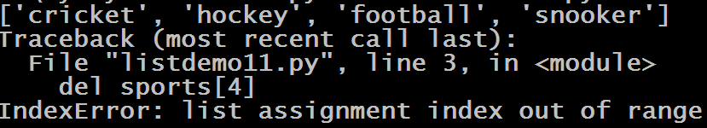
Guess The Output ?
sports=["cricket","hockey","football","snooker"]
print(sports)
del sports[4]
print(sports)
Output:
Subscript operator will generate IndexError whenever we pass invalid index

Slide 14
Deleting Multiple Items
Python allows us to delete multiple items from the list in 2 ways:
By assigning empty list to the appropriate slice
OR
By passing slice to the del operator

Slide 15
Example
Assigning Empty List
sports=["cricket","hockey","football","snooker"]
print(sports)
sports[1:3]=[]
print(sports)
Output:

Slide 16
Guess The Output ?
sports=["cricket","hockey","football","snooker"]
print(sports)
sports[1:5]=[]
print(sports)
Output:
Slice operator never generates IndexError , so the code will work fine and remove all the items from given start index to the end of the list

Slide 17
Example
Passing slice to del operator
sports=["cricket","hockey","football","snooker"]
print(sports)
del sports[1:3]
print(sports)
Output:

Slide 18
Guess The Output ?
sports=["cricket","hockey","football","snooker"]
print(sports)
del sports[1:5]
print(sports)
Output:
Here also , since we have used the slice operator , no exception will arise

Slide 19
Guess The Output ?
sports=["cricket","hockey","football","snooker"]
print(sports)
del sports[0:4]
print(sports)
Output:

Slide 20
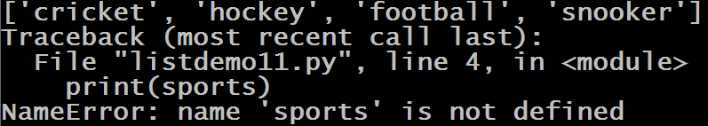
Deleting Entire List
We can delete or remove the entire list object as well as it’s reference from the memory by passing the list object reference to the del operator
Syntax:
del list_var
Example:
sports=["cricket","hockey","football","snooker"]
print(sports)
del sports
print(sports)
Output:

Slide 21
Appending Or Prepending Items To A List
Additional items can be added to the start or end of a list using the + concatenation operator or the += compound assignment operator
The only condition is that the item to be concatenated must be a list
Example:
outdoor=["cricket","hockey","football"]
indoor=["carrom","chess","table-tennis"]
allsports=outdoor+indoor
print(allsports)
Output:

Slide 22
Guess The Output ?
sports=["cricket","hockey","football"]
sports=["carrom","chess","table-tennis"]+sports
print(sports)
Output:

Slide 23
Guess The Output ?
evens=[4,6,8]
evens=2+evens
print(evens)
Output:

Slide 24

Guess The Output ?
evens=[4,6,8]
evens=list(2)+evens
print(evens)
Output:

Slide 25

Guess The Output ?
evens=[4,6,8]
evens=[2]+evens
print(evens)
Output:

Slide 26
Guess The Output ?
sports=["cricket","hockey","football"]
sports=sports+"boxing"
print(sports)
Output:

Slide 27
Guess The Output ?
sports=["cricket","hockey","football"]
sports=sports+list("boxing")
print(sports)
Output:

Slide 28
Guess The Output ?
sports=["cricket","hockey","football"]
sports=sports+["boxing"]
print(sports)
Output:

Slide 29
Multiplying A List
Python allows us to multiply a list by an integer and when we do so it makes copies of list items that many number of times, while preserving the order.
Syntax:
list_var * n
Example:
sports=["cricket","hockey","football"]
sports=sports*3
print(sports)
Output:

Slide 30
Guess The Output ?
sports=["cricket","hockey","football"]
sports=sports*3.0
print(sports)
Output:

Slide 31
Guess The Output ?
sports=["cricket","hockey","football"]
sports=sports*["boxing"]
print(sports)
Output:

Slide 32
Membership Operator On List
We can apply membership operators in and not in on the list to search for a particular item
Syntax:
element in list_var
Example:
sports=["cricket","hockey","football"]
print("cricket" in sports)
Output:

Slide 33
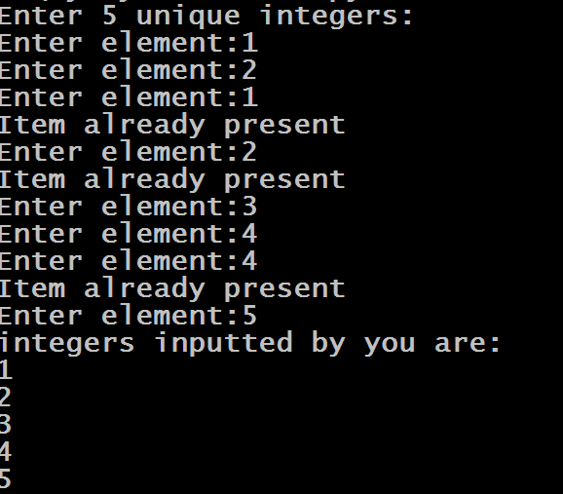
Exercise
Write a program to accept 5 unique integers from the user. Make sure if the integer being entered is already present in the list your code displays the message “Item already present” and ask the user to reenter the integer.
Output:

Slide 34
Solution
myints=[]
print("Enter 5 unique integers:")
i=0
while i<=4:
item=int(input("Enter element:"))
found=False
for x in myints:
if x==item:
print("Item already present")
found=True
break;
if found==False:
myints.append(item)
i=i+1
print("integers inputted by you are:")
for x in myints:
print(x)

Slide 35
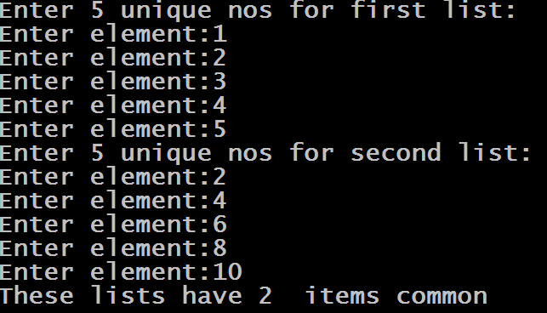
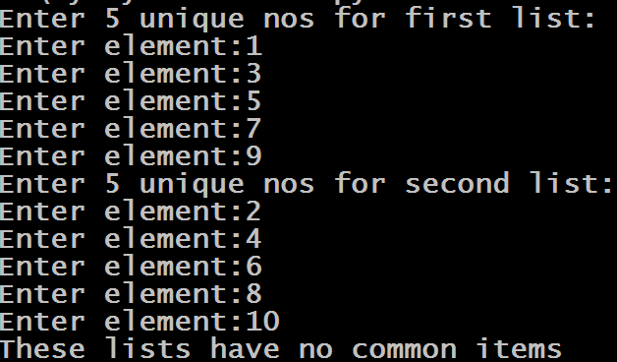
Exercise
Write a program to accept 2 lists from the user of 5 nos each . Assume each list will have unique nos Now find out how many items in these lists are common .
Output:

Slide 36
Solution
list1=[]
list2=[]
print("Enter 5 unique nos for first list:")
for i in range(1,6):
item=int(input("Enter element:"))
list1.append(item)
print("Enter 5 unique nos for second list:")
for i in range(1,6):
item=int(input("Enter element:"))
list2.append(item)
count=0
for x in list1:
for y in list2:
if x==y:
count=count+1
if(count==0):
print("These lists have no common items")
else:
print("These lists have",count," items common")

Slide 37
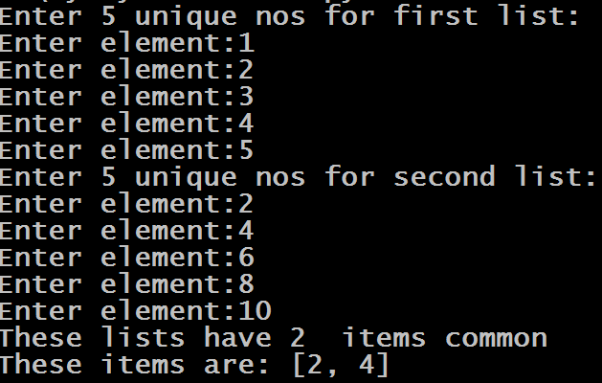
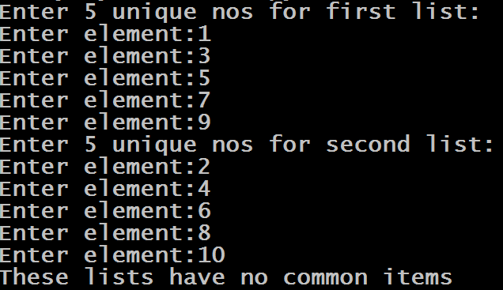
Exercise
Rewrite the previous code so that your code alos displays the items which are common in both the lists
Output:

Slide 38
Solution
list1=[]
list2=[]
list3=[]
print("Enter 5 unique nos for first list:")
for i in range(1,6):
item=int(input("Enter element:"))
list1.append(item)
print("Enter 5 unique nos for second list:")
for i in range(1,6):
item=int(input("Enter element:"))
list2.append(item)
for x in list1:
for y in list2:
if x==y:
list3.append(x)
if(len(list3)==0):
print("These lists have no common items")
else:
print("These lists have",len(list3)," items common")
print("These items are:",list3)

